Slide 1
Name : JAKIRUL ISLAM
Id. 193002101
Department: CSE
Batch: 193
Section: C

Slide 2
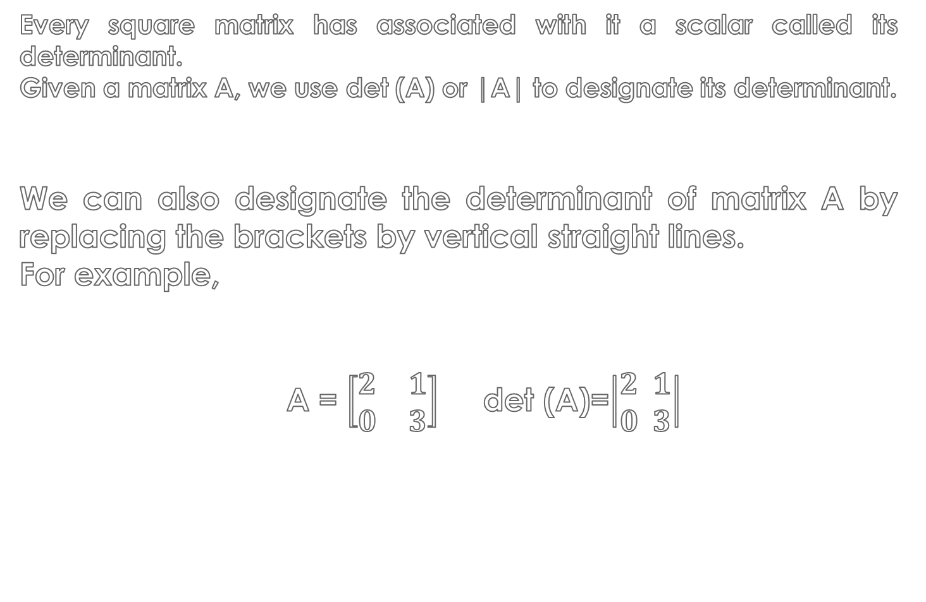
DETERMINANT
Every square matrix has associated with it a scalar called its determinant.
Given a matrix A, we use det (A) or |A| to designate its determinant.
We can also designate the determinant of matrix A by replacing the brackets by vertical straight lines.
For example,
A = $\left[\begin{matrix}2 & 1 \\ 0 & 3\end{matrix}\right]$ det (A)=$\left|\begin{aligned}2 1 \\ 0 3\end{aligned}\right|$

Slide 3

Defnition 1: The determinant of a 1x1 matrix [a] is the scalar a.
Definition 2: The determinant of a 2x2 matrix $\left[\begin{matrix}a & b \\ c & d\end{matrix}\right]$ is the scalar ad-bc.

Slide 4

Example:
Evaluate the determinate : $\left[\begin{matrix}4 & −3 \\ 2 & 5\end{matrix}\right]$
Solution: $\left[\begin{matrix}4 & −3 \\ 2 & 5\end{matrix}\right]$= 4 x 5 – 2 x (-3)
= 20 + 6
= 26

Slide 5


Evaluate the determinate: $\left[\begin{matrix}2 & 3 & −5 \\ 7 & 1 & −2 \\ −3 & 4 & 1\end{matrix}\right]$
Solution :
$\left[\begin{matrix}2 & 3 & −5 \\ 7 & 1 & −2 \\ −3 & 4 & 1\end{matrix}\right]$ =2$\left[\begin{matrix}1 & −2 \\ 4 & 1\end{matrix}\right]$ - 3$\left[\begin{matrix}7 & −2 \\ −3 & 1\end{matrix}\right]$+ (-5)$\left[\begin{matrix}7 & 1 \\ −3 & 4\end{matrix}\right]$
[Expanding along first row]
=2(1+8)-3(7-6)-5(28+3)
=18-3-155
=-140

